Slide 1
What can you control? vs What can’t you control?
Celina High School
Guidance Lesson

Slide 2
Introduction
What is control?
What is in my control?
What is out of my control?
How do I go about this?

Slide 3
Control
The power to influence or direct people's behavior or the course of events.

Slide 4
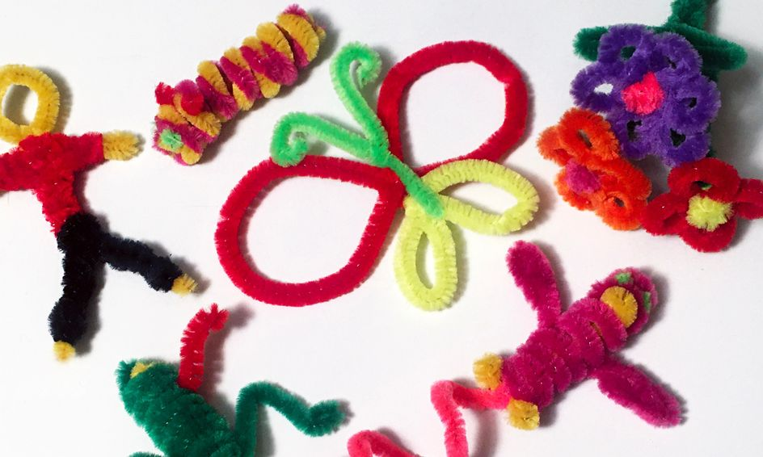
Imagine you have a Rock and a Pipe Cleaner

Slide 5
What does it feel like when your not in control?
Worried
Overwhelmed
Scared/Fearful
I’m drowning
Hopeless

Slide 6
I can control…
Where my focus is from moment to moment
My reaction to situations
Where I spend or invest my time
How much effort I put in
How I show up

Slide 7
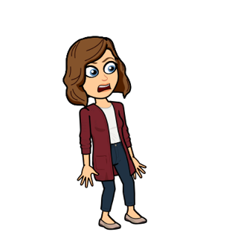
I can’t control…
Change
The weather
The past
Other people’s opinions
Other people’s actions

Slide 8
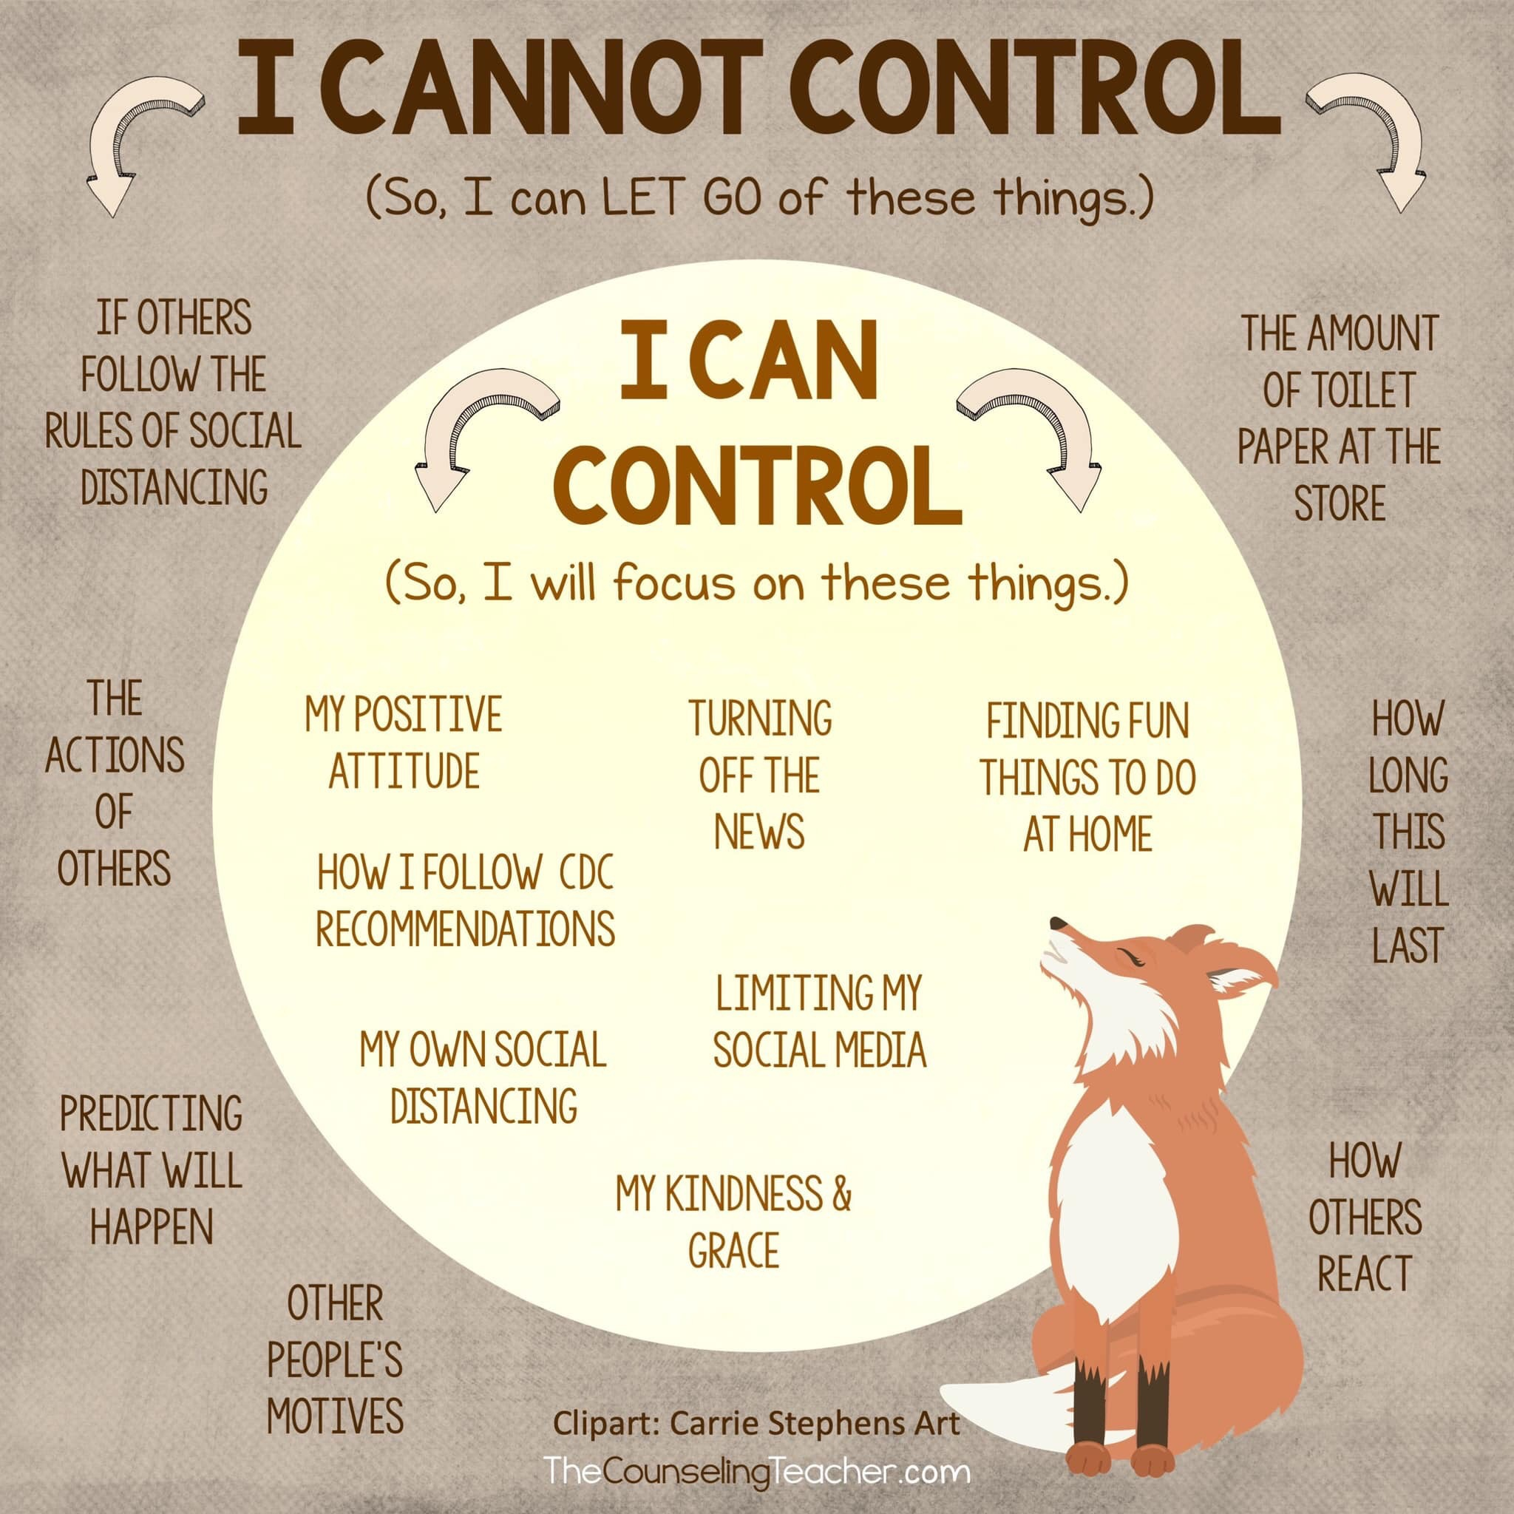

Slide 9
Focus on what you CAN control!

